Slide 1

WELCOME semester jul-dec 2021

Slide 2

I am Adriana Anaya Estrada
I studied the BA in English languge Teaching at the UAEH. I have been teaching English for almost 18 years. Feel free to contact me on
aanaya@uaeh.edu.mx
Hello!

Slide 3

ACCOMPLISHMENTS AND EXPERIENCES. Foreign language

Slide 4

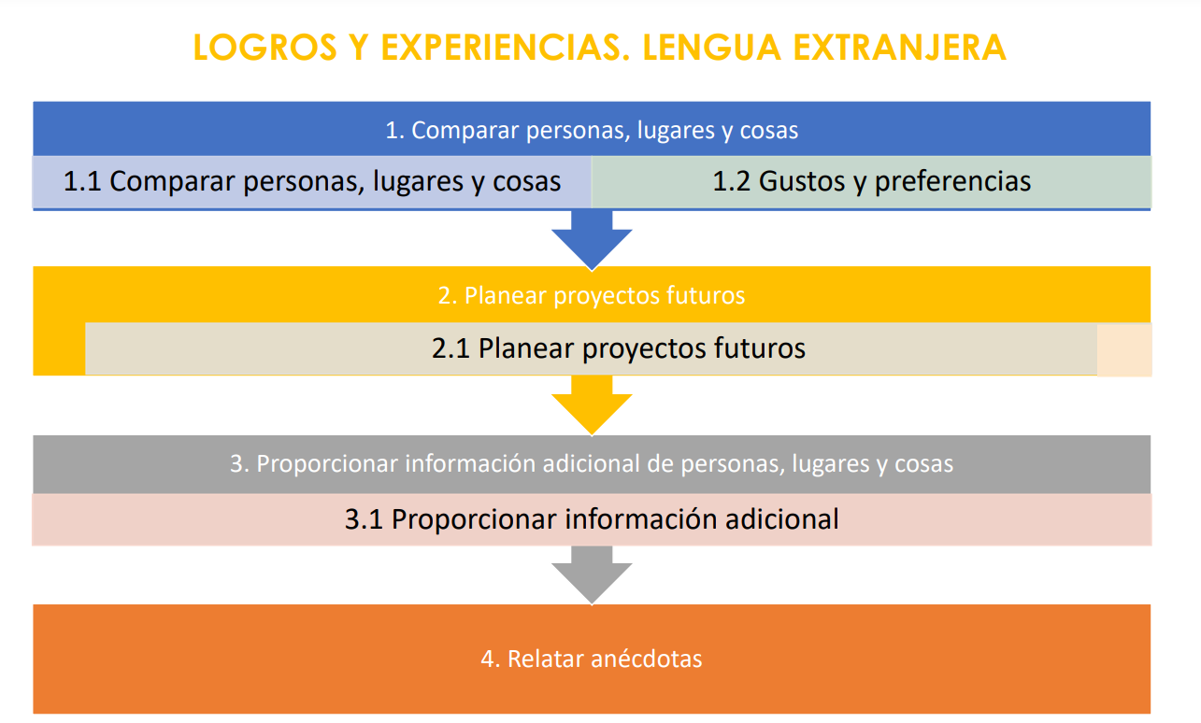

Slide 5

THIS IS A SLIDE TITLE
Evaluation
HeteroevaluaCION 90%
PEER-ASSESSMENT 5%
Self-ASSESSMENT 5%

Slide 6
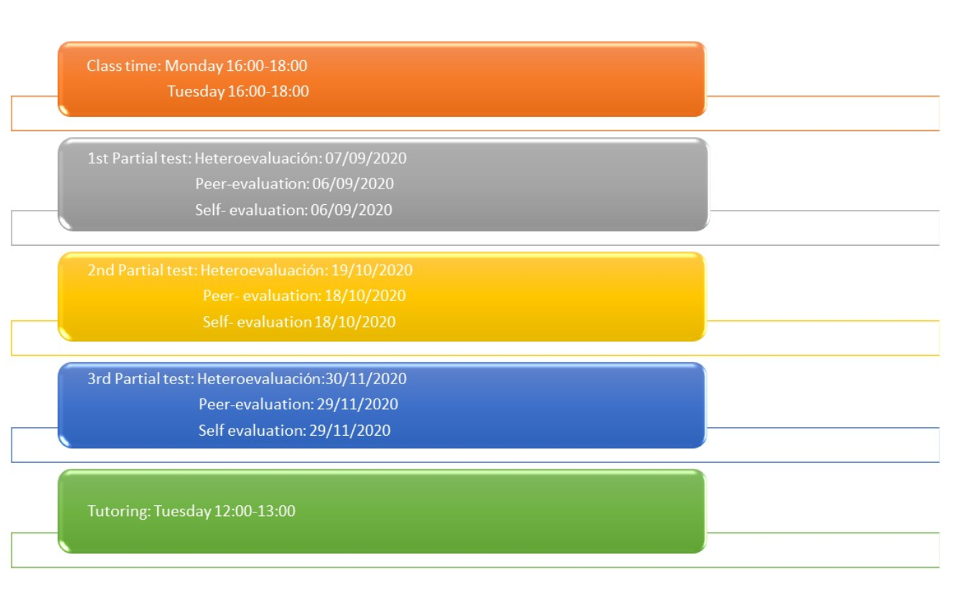

Slide 7

Progress test | >Reading >Listening >Writing >Use of English >Speaking | 60% | On the Plataforma Garza
Self learning activities | CAI activities | 10% | Online activities in the format (click here)
Portfolio | Tasks / homework, presentations and session meet activities Periodic quizes Digital library | 30% | Those activities must be uploaded on time . Students must participate on Meet sessions

Slide 8

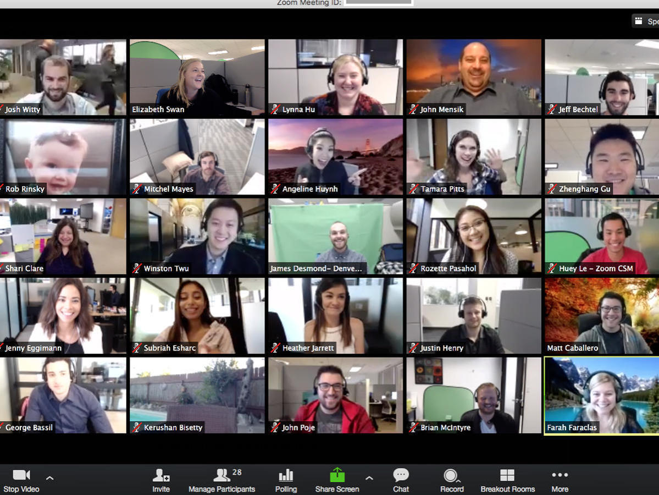
We will have a zoom meeting once a week

Slide 9
Important:
-You must deliver your activities on time (Fridays will be the deadline each week). Activities will be available since Monday each week or before.
There will be rubrics for every of the products to deliver.
Questions will be answered by mail (or through the head of the group) just in working hours. (see the Schedule on Garza Platform)
All the sessions will be on meet.
Diagram featured by http://slidemodel.com

Slide 10

please: Read carefully all the instructions of the activities on the platform
I will provide you with extra material and exercises if necessary and all questions will be answered on meet sessions, so be prepared beforehand.

Slide 11
Presentation design
Thanks!
Any questions?
Find me at
aanaya@uaeh.edu.mx

